Slide 1
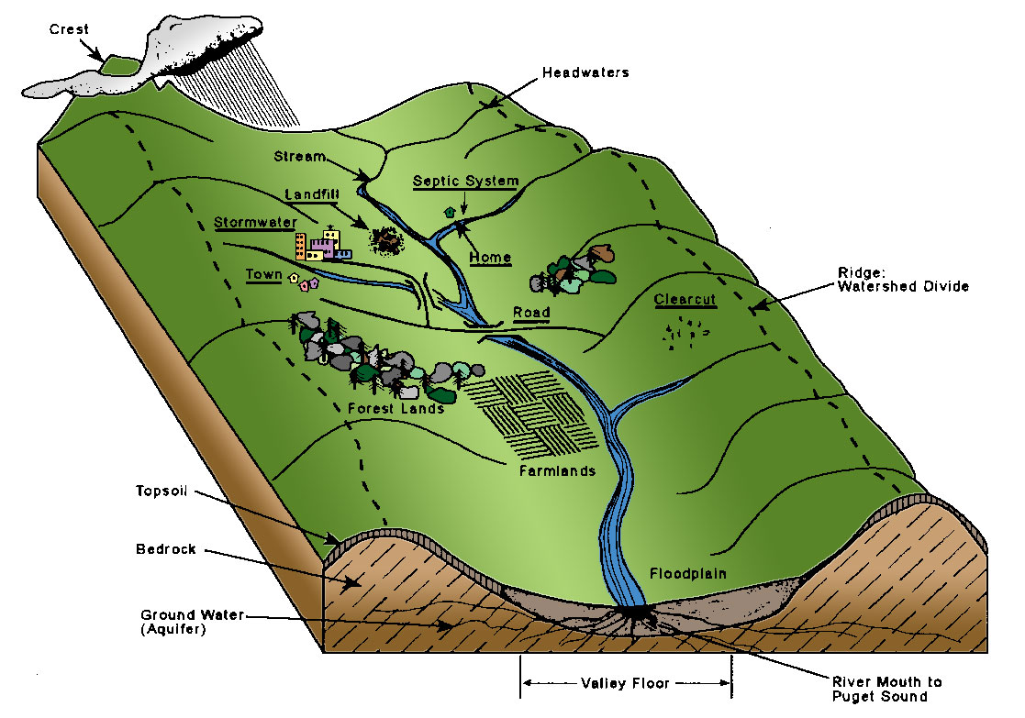
Watershed: an area of land where all the H₂O drains to the same place More poetic: "that area of land, a bounded hydrologic system, within which all living things are inextricably linked by their common water course and where, as humans settled, simple logic demanded that they become part of a community.“ John Powell

Slide 2
Know your HUC
Before states, cities, counties… you were known by your watershed!
Hydrological unit code HUC!
More digits, more “specific”
HUC-2 (17) is the pacific northwest
HUC-4 (1706): Lower Snake River
HUC-8 (17060108): Palouse
HUC-12 (170601080202) is our specific drainage

Slide 3
Our watershed

Slide 5
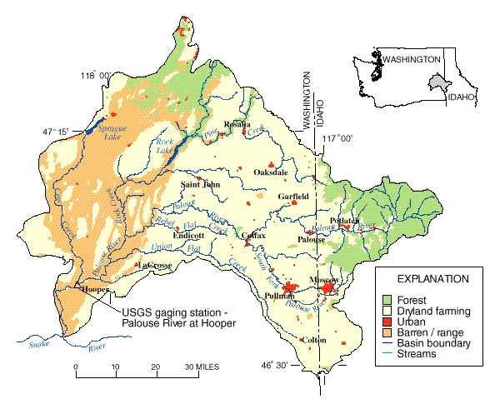

Slide 6
Our watershed

Slide 8
Group Assignments
5
3
4
2
1

Slide 9
Assignment
In your group (From Friday), take a watershed tour
Follow the river to its headwaters on Moscow Mountain,
What impacts the water quality?
Farming, roads, straightening, livestock, houses, industrial, parking lots, parks, fields, playing fields/grass, etc…
Google maps, Google earth, personal knowledge, etc…
Class Presentation:
Group 1: South of Troy Highway to Buffalo Hump
Group 2: In town to Mtn View Park (City limit to North)
Group 3: Mtn View park to headwaters
Group 4: Downstream of our site to WA State Line
Group 5: Stateline to the Snake

